Slide 1

Classification using Logistic Regression
Michigan Hackers Machine Learning Team

Slide 2
Agenda
Icebreaker
Gradient Descent Code Walkthrough
Introduction to Classification
Introduction to Logistic Regression
Implement Logistic Regression
Work and Ask Questions

Slide 3

Ice Breaker
Breakout into smaller groups and talk about where you would want to visit after quarantine ends.

Slide 4
Gradient Descent Code Walkthrough

Slide 5
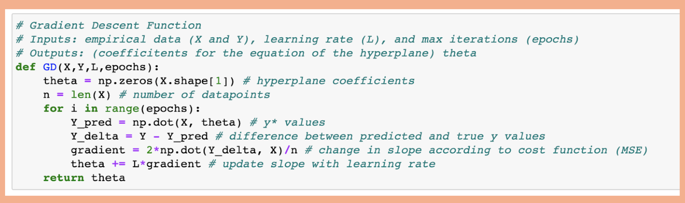
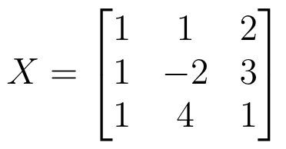
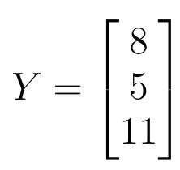
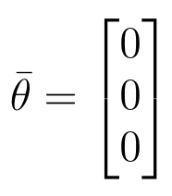
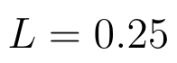
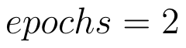
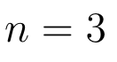
Declarations

Slide 6
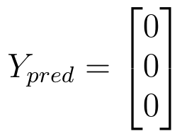
First time through for loop (first epoch)

Slide 7
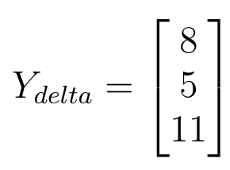
First time through for loop (first epoch)

Slide 8
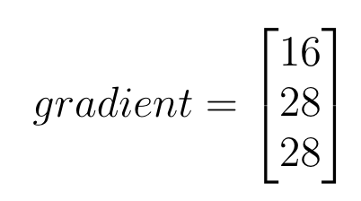
First time through for loop (first epoch)

Slide 9
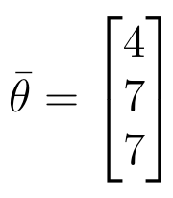
First time through for loop (first epoch)

Slide 10
Second time through for loop (2nd epoch)
Try on your own!

Slide 11
Classification

Slide 12
The Classification Problem
In machine learning, classification refers to a predictive modeling problem where a categorical label is predicted for a given example of input data.
Examples of classification problems include:
Classify emails as spam/not spam
Classify a Yelp Review as positive/negative
Classify handwritten numbers as digits 0-9
Label encoding is the mapping of class labels to unique integer values.
y ∈ {-1,1}
0: “Negative class” (eg. not spam)
1: “Positive class” (eg. spam)

Slide 13
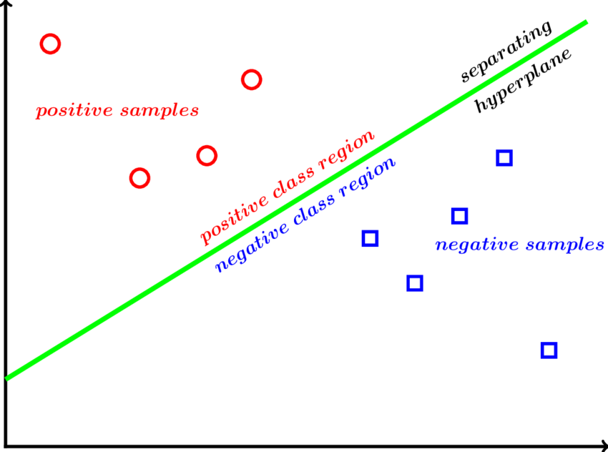
Binary Classification

Slide 14
Logistic Regression

Slide 15
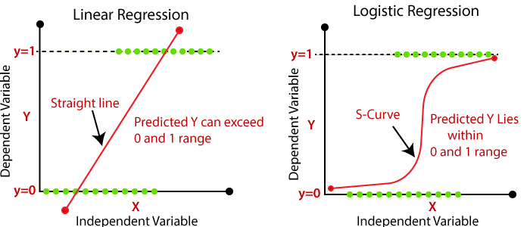
Logistic Regression

Slide 16
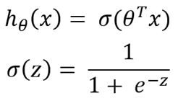
Logistic Regression Model
h(x) represents the estimated probability that y=1 on input x.
Eg: For some email, if h(x) = .7, then there is a 70% chance the email is spam.
Since there are only two possibilities for h(x) (0 or 1), there is a 30% chance the email is not spam.

Slide 17
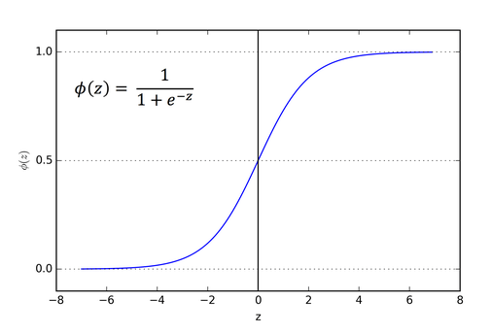
Sigmoid Function

Slide 18
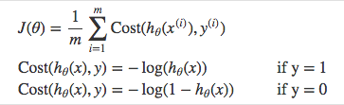
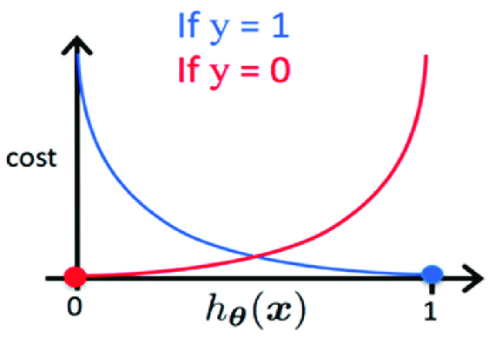
Cost Function for Logistic Regression

Slide 19
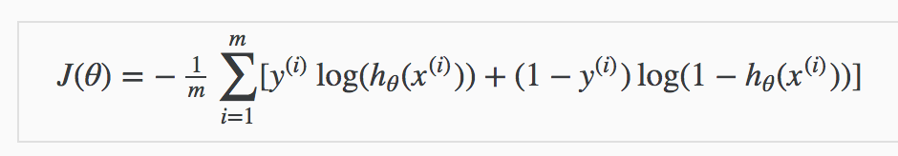
Condensed Cost Function

Slide 20
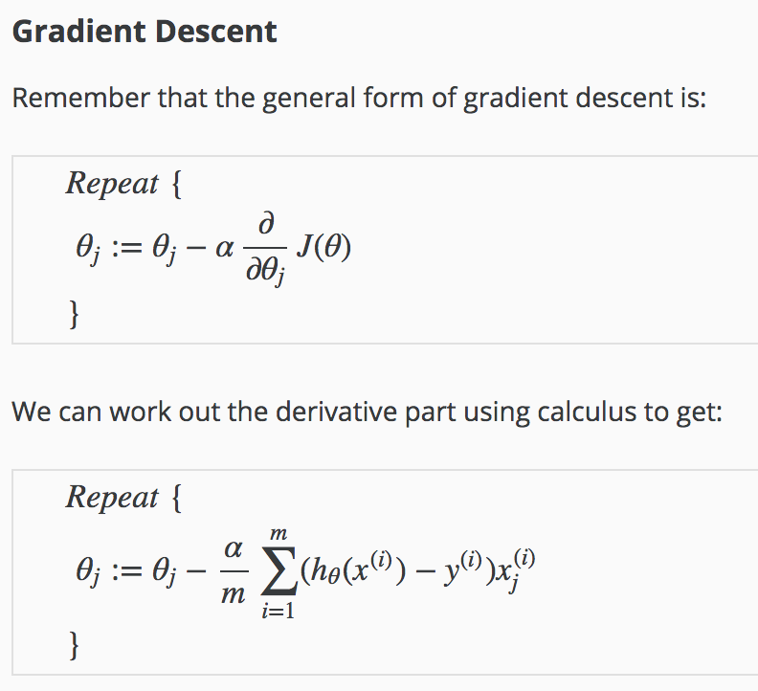

Slide 21
Logistic Regression in Python

Slide 22
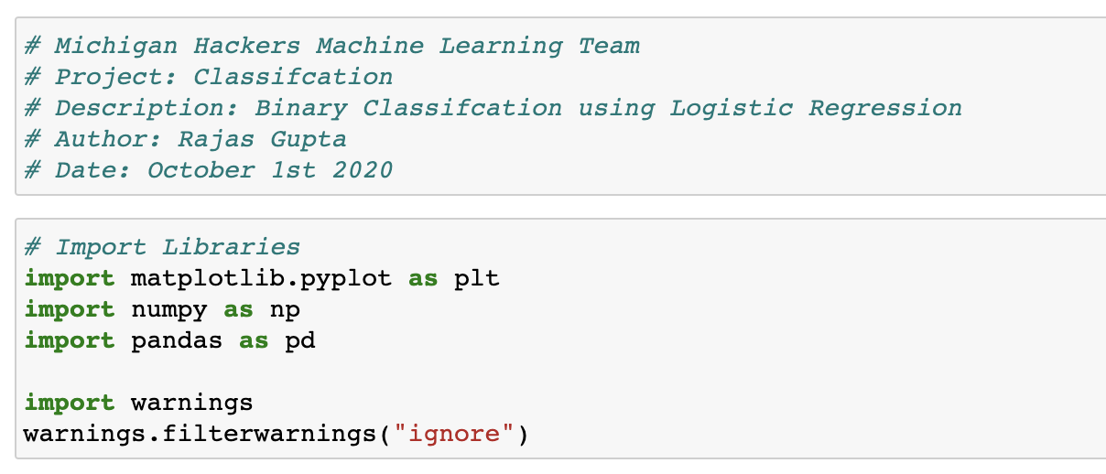
Setting Up

Slide 23
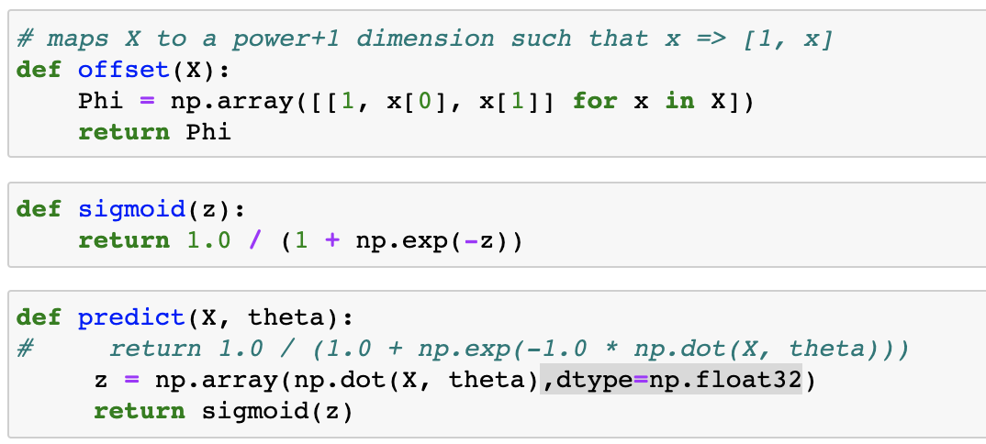
Helper Functions

Slide 24
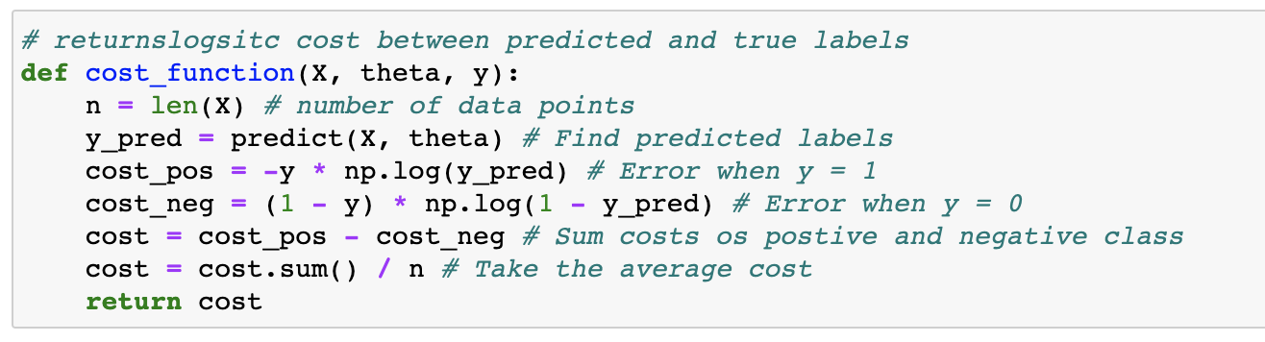
Cost Function

Slide 25
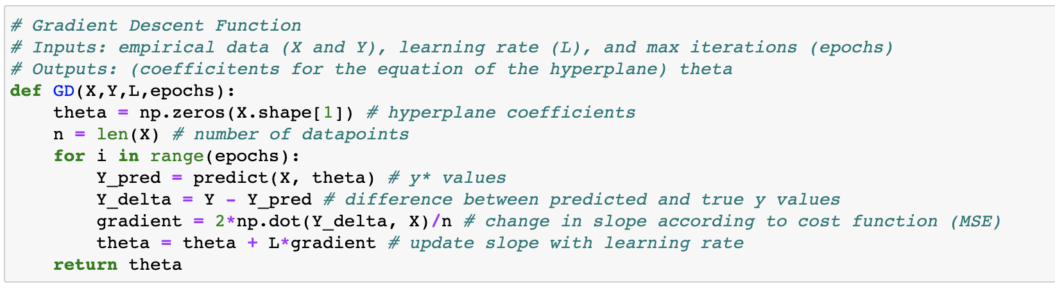
Gradient Descent Algorithm

Slide 26
Work and Ask Questions
Last week to complete the small linear regression project:
Starter code (SLR_GD.ipynb) and dataset (yoe_sal.cv) found here
Remember to put the dataset in the same folder as your starter code
Use the last part of these slides as reference
Upload your notebook here
If done: Watch at least the first video of Andrew Ng’s logistic regression series. If you don’t know who Andrew Ng is, look him up!
Questions about any topic, onboarding, or computer setup
For next week:
Beginner: Continue working on Python 3 Programming Specialization on Coursera. Use the practice feature of the interactive textbook
Intermediate: Read chapter 8 and 14 of Data Science from Scratch. Practice writing code in Jupyter as you go

Slide 27

Thank You!
Michigan Hackers Machine Learning Team
Contact Info:
Rajas Gupta | rajasg@umich.edu
Vijay Shamra | vsharm@umich.edu
Provide Feedback

